Slide 1
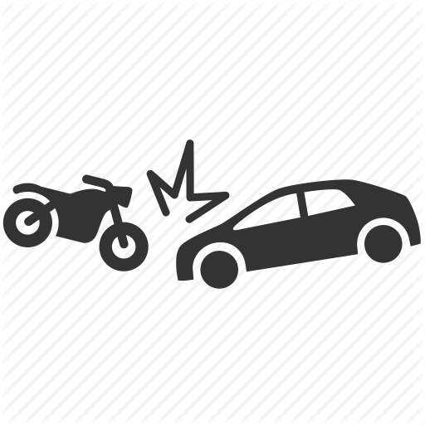
Did You Know?
Count of 7000 people are killed by influence of alcohol.
Over 11,000 children below 18 are dying ever year.
More than 10,000 riders are dying by without wearing helmet.
Approx.70,000 college students are died per year.
22,000 accidents are occurring every month because of drowsiness.
4 people die every hour in India because they do not wear a helmet.
Tamilnadu hold top 2nd position in most accidental zone in India.

Slide 2
Enhancing Road Safety System Using ML Techniques

Slide 3


K.Mugunthan
Cse,Nandha College Of Technology
CEO @ So-called Engineers
Our Team
Nandha Kumar C
Cse,Nandha College Of Technology
CTO @ So-called Engineers

Slide 4
Abstract
The most important aspects in an accident investigation are the license plate recognition and driver drowsiness detection. License plate recognition is divided into three stages: license plate detection, individual number and character extraction, and number and character recognition. Driver drowsiness detection algorithm is based on the state of eyes of the driver which is determined by his iris visibility. If driver’s eyes remain in one state either open or closed longer than expected time. It is an indication that driver is drowsy and then the system warns the driver by making alarm. The Alcohol sensor fixed on helmet is used to prevent drink and drive scenarios.

Slide 5
Content
01
Introduction
02
Related Work
03
Proposed Work
04
Result Analysis & Comparison
05
Conclusion

Slide 6
Introduction
We know that young generation prefers bikes and motorcycle over four wheelers. Moreover speeding and drunk driving have become common issues.
Due to lack of our experience or focus and violation of traffic rules, result in several accidents. So with the help of technology we are creating the idea of developing this project comes from our social responsibility towards society.
Almost all vehicle are captured in CCTV cameras. Hence it is not easy to detect and recognize license plate correctly. To overcome this problem, we propose an algorithm that automatically recognizes license plate using a CCTV camera footages.

Slide 7
Modules
Drowsiness driver detection
Automatic number plate detection
Smart helmet bike starter with alcohol detection

Slide 8
Related Work
Automatic number plate detection
The existing system using OCR was found to have the following drawbacks:
Misidentification.
Hazy images.
Flaws in angular detection.
Drowsiness driver detection
The open CV detector detects only 40% of face of driver in normal driving position in video recording of 10 minutes.
In the oblique view, the Open CV eye detector (CV-ED) frequently fails to trace the pair of eyes.
Hence existing system is not applicable for large vehicles.

Slide 9
Related Work
Smart helmet bike starter with alcohol detection
The related project basically has a wired communication and is connected to a Microcontroller. First we have to ensure that weather rider is wearing helmet or not.
This has following disadvantages:
Rider does not wear helmet in regions where traffic checking is not done.
Testing alcohol content present in blood in each individual rider in big countries like India is impossible.
Difficulty of implementation of traffic rules by traffic police.

Slide 10
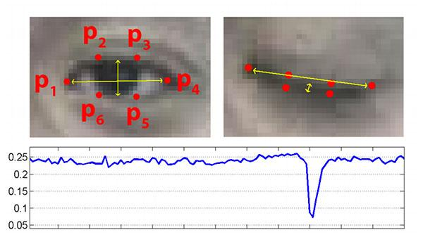
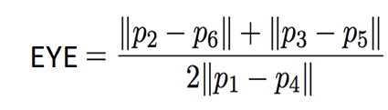
Proposed System
Drowsiness driver detection
Blink detection can be estimated by measuring EAR (Eye aspect Ratio) using OPENCV functions.
DLIB’s pre trained Neural network based prediction and detector function.
Results of facial Landmark detection and identification of eye coordinates.

Slide 11
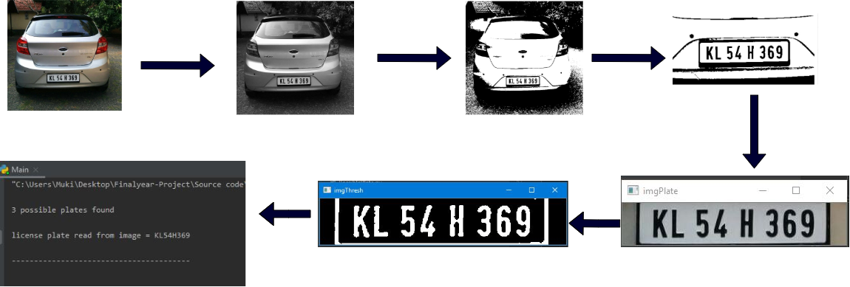
Proposed System
Automatic number plate detection - ”Euclidean algorithm”
We proposed to use K-nearest neighbour (KNN) classifiers to recognize these segmented characters.
Their recognition rates are 96.97 % (PNN) and 99.77 % (KNN), respectively. The K-nearest neighbour (KNN) classifier uses features of testing image returns recognized character.
License Plate Detection through KNN

Slide 12
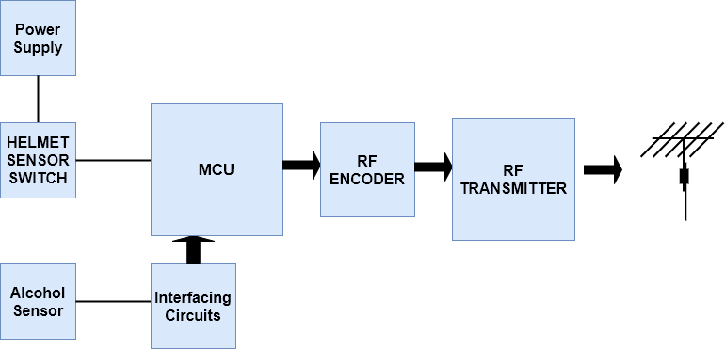
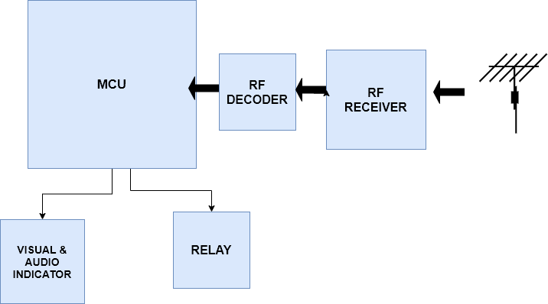
Smart helmet bike starter with alcohol detection
HELMET SECTION
BIKE SECTION

Slide 13
RESULT & ANALYSIS
Drowsiness driver detection
Instance | Closed Eyes | Real Drowsing | Generated Warring | False Positive | False Negative | Correct Warning | Precision Rate % | Average Precision Rate %
Instance 1 | 43 | 9 | 9 | 0 | 0 | 9 | 100.0
Instance 2 | 48 | 12 | 14 | 2 | 0 | 12 | 85.7
Instance 3 | 37 | 16 | 18 | 2 | 0 | 16 | 88.8 | 90.5
Instance 4 | 40 | 8 | 8 | 0 | 0 | 8 | 100.0
Instance 5 | 44 | 11 | 12 | 1 | 0 | 11 | 91.6
Instance 6 | 37 | 10 | 13 | 3 | 0 | 10 | 76.9

Slide 14
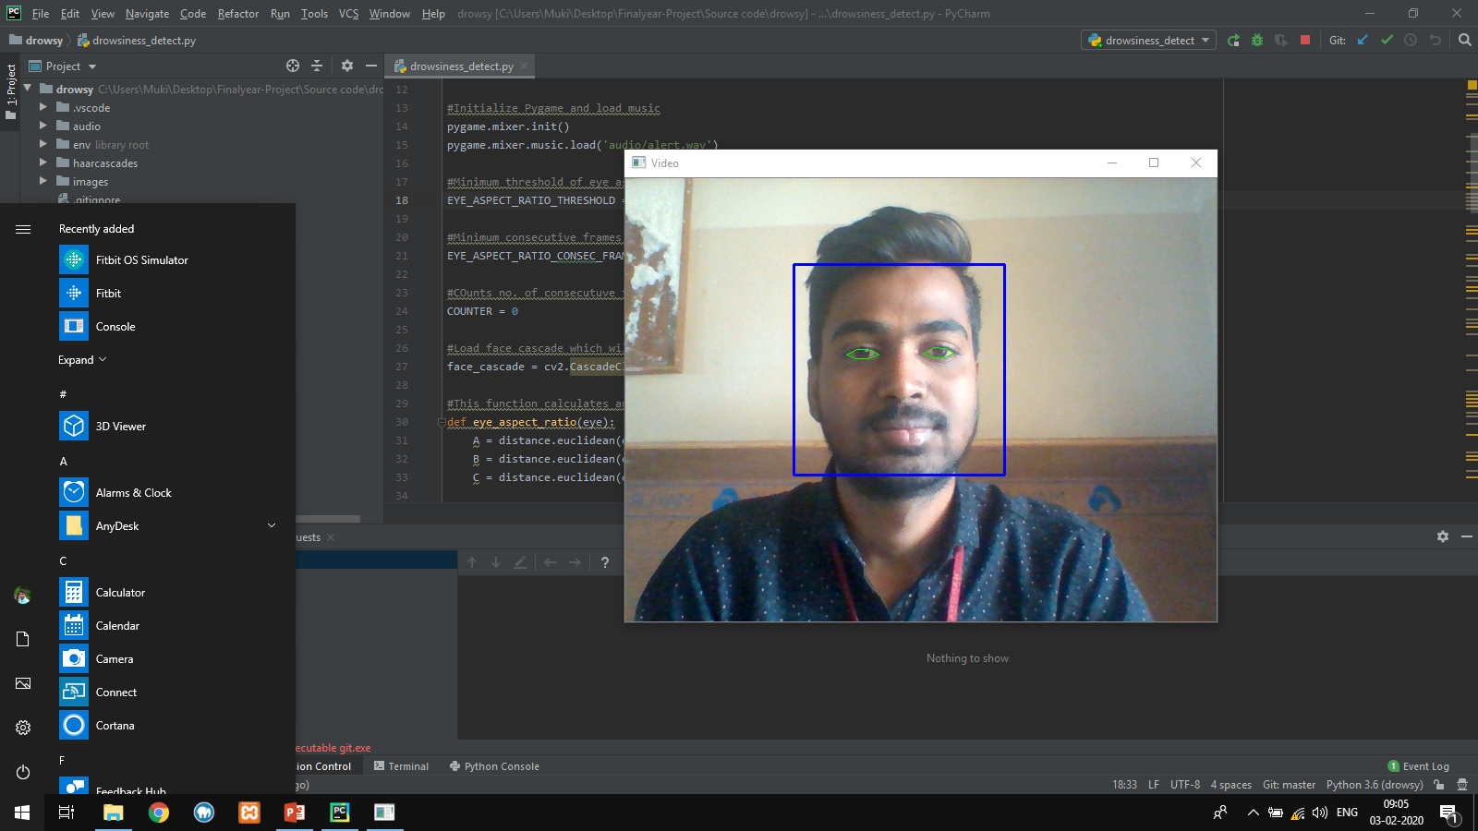
Screen Shots

Slide 15
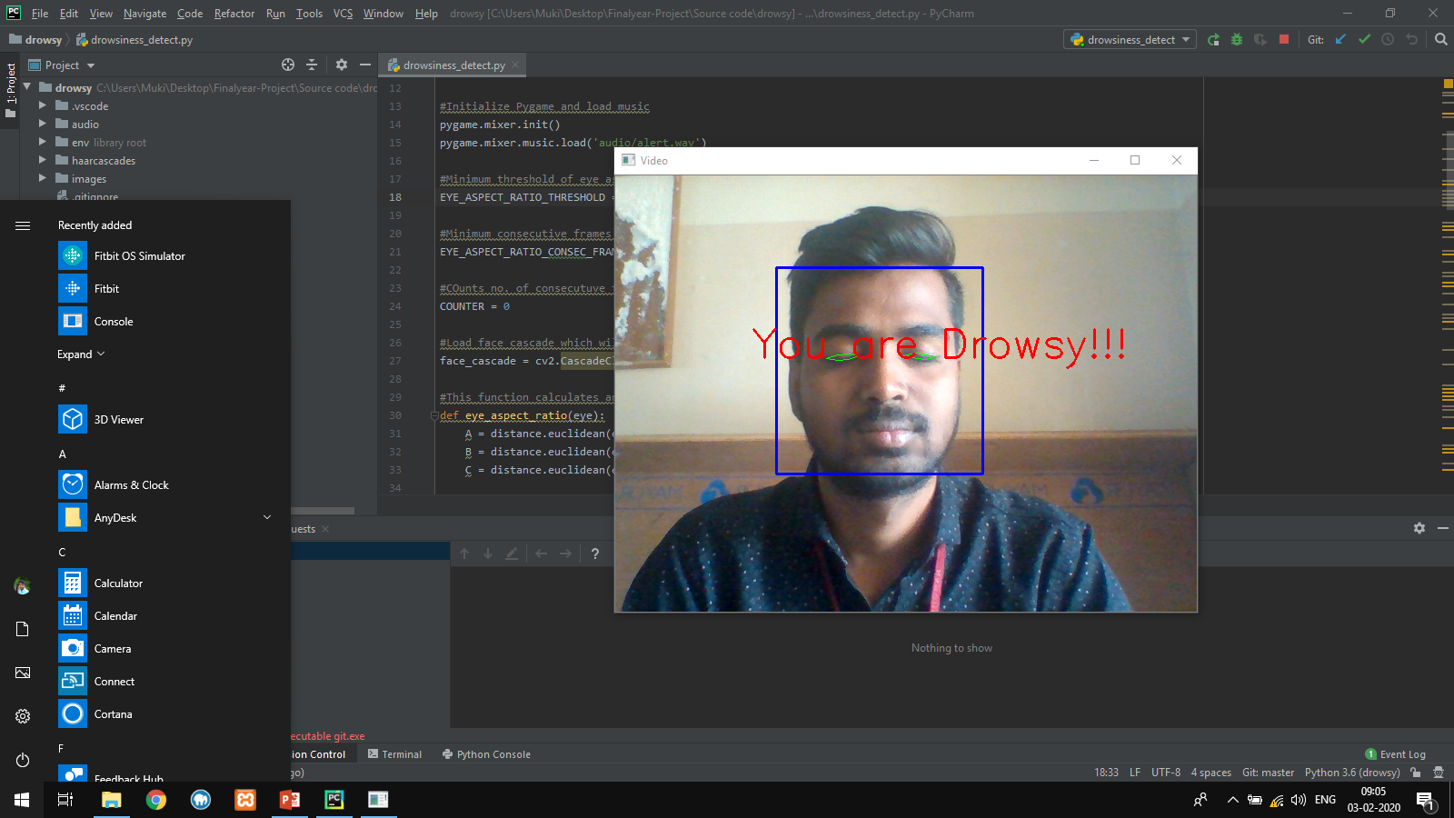
Screen Shots

Slide 16
RESULT & ANALYSIS
Automatic number plate detection
Groups Plates | Total License Plates | No. of Detected License | Detection Rate (%)
Group A | 10 | 8 | 80.0
Group B | 10 | 9 | 90.0
Group C | 10 | 9 | 90.0
Combine Results of 3 Groups | 30 | 28 | 93.3

Slide 17
Conclusion
The proposed system is to address a solution to one of the major causes of the road accident, the system will notify him when his eyes get closed in order to avoid losing the control of the car and causing traffic accidents.
Real time number plate detection and recognition system that allows to “read” license place information in an automated way.The comparison between our proposed system’s tesseract-ocr and other OCR engines in result shows that tesseract-ocr has better accuracy.
The developed project efficiently ensures:
• Rider is wearing helmet throughout the ride.
• Rider should not be under the influence of alcohol.

Slide 18
THANK YOU !

Slide 19
Any Query??

